Slide 1

Rossmann Pharmaceuticals
Sales prediction
across multiple stores
NextHikes
SUBMITTED BY: SUMIT M. RAUT

Slide 2
Introduction
Predicting sales performance is one of the key challenges every business face.
It is important for firms to predict customer demands to offer the right product at the right time and at the right place.
The importance of this issue is underlined by the fact that figuratively a bazillion consulting firms are on the market trying to offer sales forecasting services to businesses of all sizes.

Slide 3
Problem Statement
Rossmann operates over 3,000 drug stores in 7 European countries.
Currently, Rossmann store managers are tasked with predicting their daily sales for up to six weeks in advance.
Store sales are influenced by many factors, including promotions, competition, school and state holidays, seasonality, and locality.
With thousands of individual managers predicting sales based on their unique circumstances, the accuracy of results can be quite varied.

Slide 4
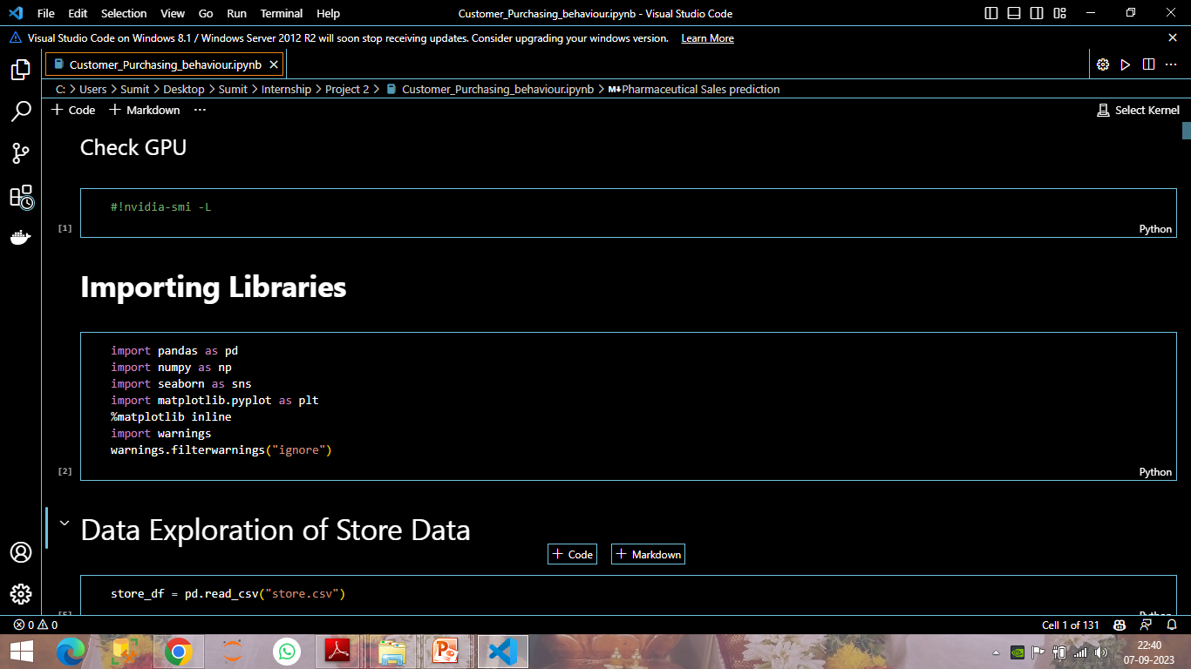
Data Collection and Pre-processing
These are the python libraries we used for Loading, cleaning, manipulating and Visualizing the data .

Slide 5
Data and Features
Datasets contain historical sales data for 1,115 Rossmann stores.
Data fields
Most of the fields are self-explanatory. The following are descriptions for those that aren't.
Id - an Id that represents a (Store, Date) duple within the test set
Store - a unique Id for each store
Sales - the turnover for any given day (this is what you are predicting)
Customers - the number of customers on a given day.

Slide 6
Open - an indicator for whether the store was open: 0 = closed, 1 = open
StateHoliday - indicates a state holiday. Normally all stores, with few exceptions, are closed on state holidays. Note that all schools are closed on public holidays and weekends. a = public holiday,
b = Easter holiday, c = Christmas, 0 = None
SchoolHoliday - indicates if the (Store, Date) was affected by the closure of public schools.
StoreType - differentiates between 4 different store models: a, b, c, d.
Assortment - describes an assortment level: a = basic, b = extra, c = extended.

Slide 7
CompetitionDistance - distance in meters to the nearest competitor store
CompetitionOpenSince[Month/Year] - gives the approximate year and month of the time the nearest competitor was opened.
Promo - indicates whether a store is running a promo on that day
Promo2 - Promo2 is a continuing and consecutive promotion for some stores: 0 = store is not participating, 1 = store is participating
Promo2Since[Year/Week] - describes the year and calendar week when the store started participating in Promo2.

Slide 8
PromoInterval - describes the consecutive intervals Promo2 is started, naming the months the promotion is started anew. E.g. "Feb,May,Aug,Nov" means each round starts in February, May, August, November of any given year for that store.

Slide 9
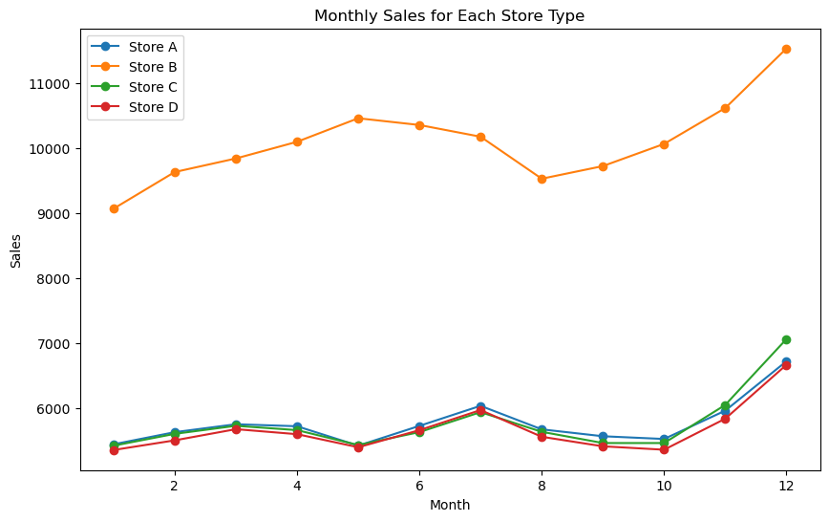
Exploratory Data Analysis
From above plot shows that Store-A, Store-C, Store-D have similar sales behaviour but Store-B have most sales behaviour as compare to Store A,C,D.

Slide 10
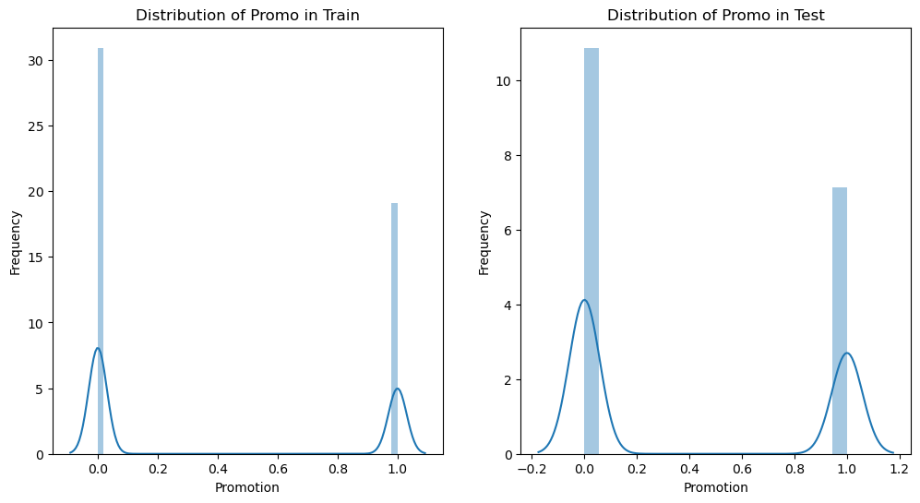

Slide 11
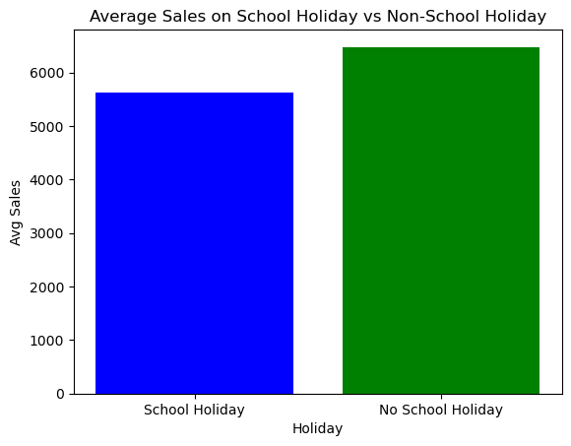
The overall avg. sales of No School Holiday is higher than School Holiday.

Slide 12
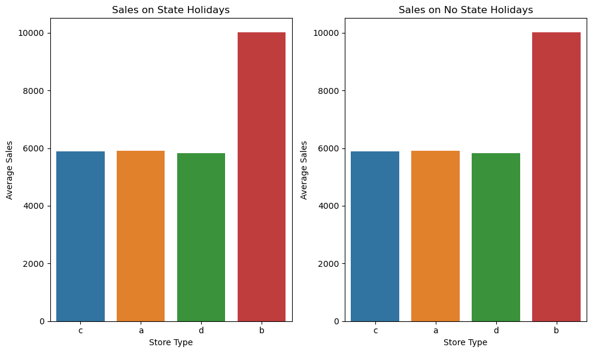
From above plot showing us that there is no such difference in Sales on State Holiday and Non State Holiday.
Store B has most sales than Store A,C and D.

Slide 13
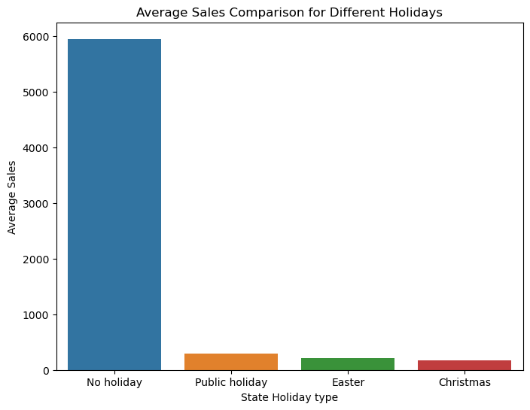
Sales on Public holiday, Easter and Christmas are very low as compare to No Holiday.
Christmas average sale is most less than other public holiday.

Slide 14
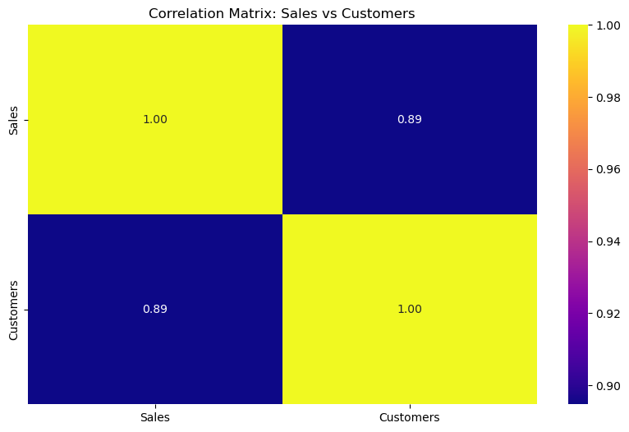
Correlation between Sales and Customers: 0.8947
Sales is positively correlated with the Customers.

Slide 15
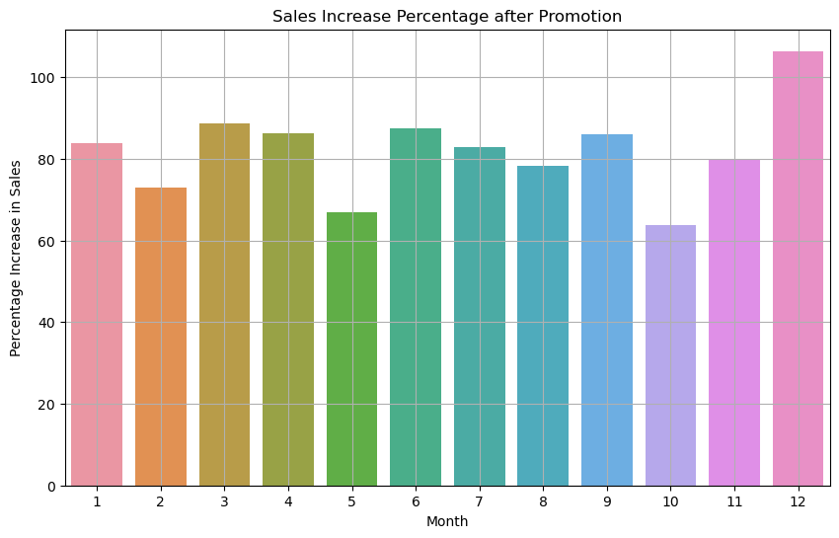

Slide 16
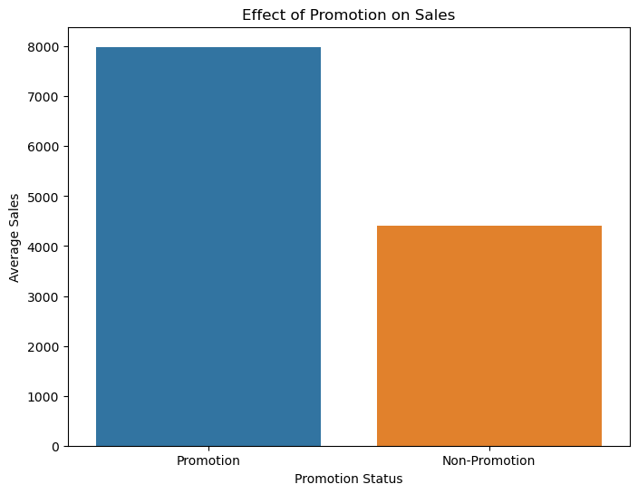
From above graphs it shows that in Dec. highest sales occur due to promotion on earlier months.
It shows positive effect on sales and customer increase rate.

Slide 17
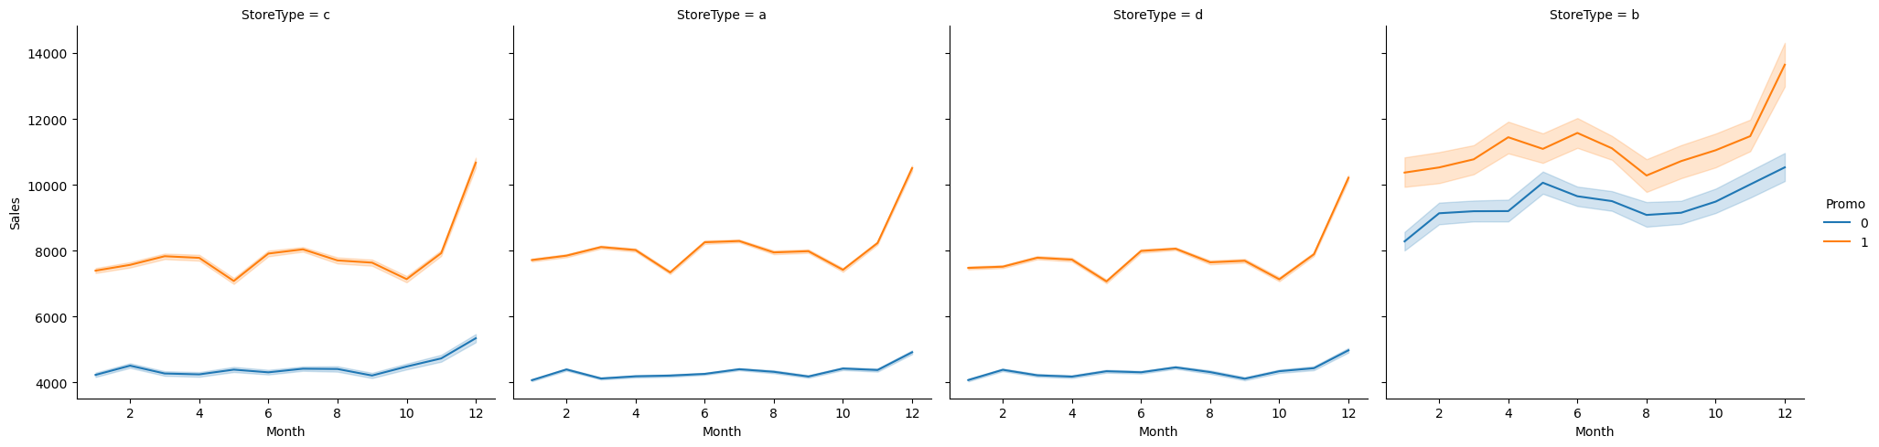
For store type a, c and d, promotion has a very significant effect on increasing sales. but in store type b, it has less on effect
Applying promotion more on store type A, B and C is more effective.
Applying promotion on Store b is not effective.

Slide 18
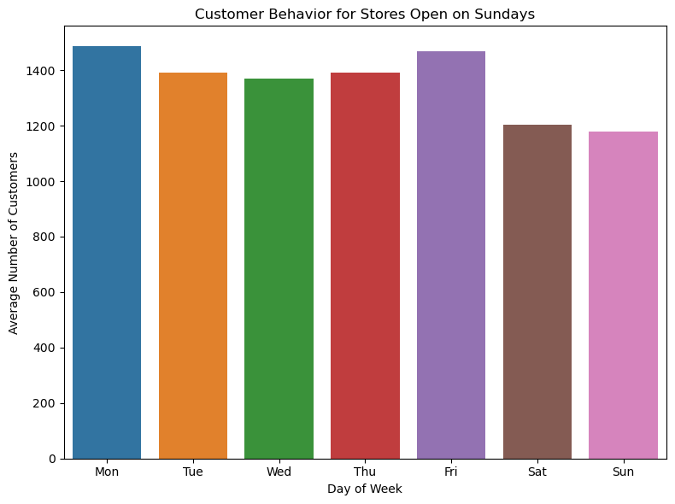
The average number of customers came to stores on Sunday is not as much lower than remaining days of week
Therefore if the stores will open on Sunday it will beneficial for sales.

Slide 19
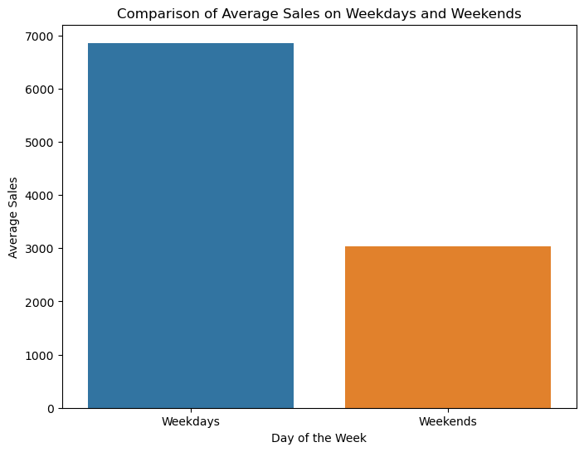
There are 927 stores that are open on all weekdays.
Average Sales on Weekdays = 6861.21 and Average Sales on Weekends = 3033.53, there is clear difference between the sales on Weekdays and Weekends.

Slide 20
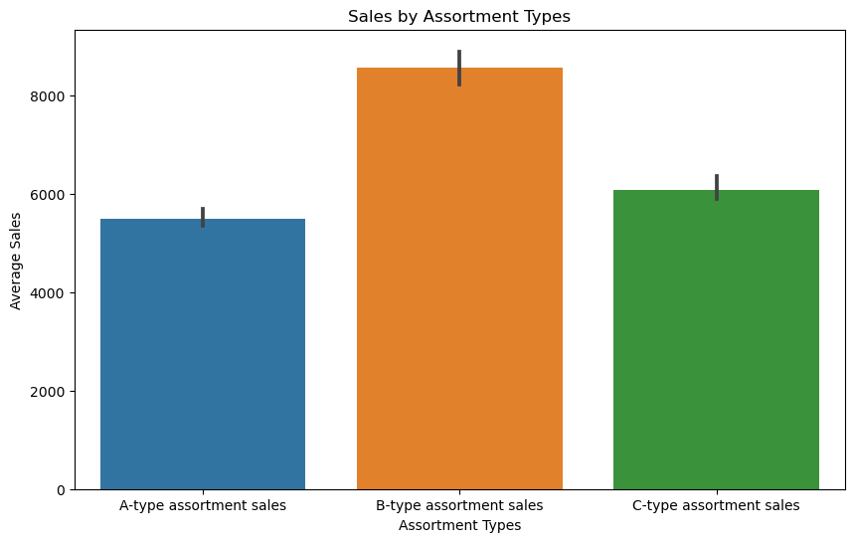
The Avg Sales on B-type assortment is very high.
The Avg Sales on A-type assortment is the lowest.

Slide 21
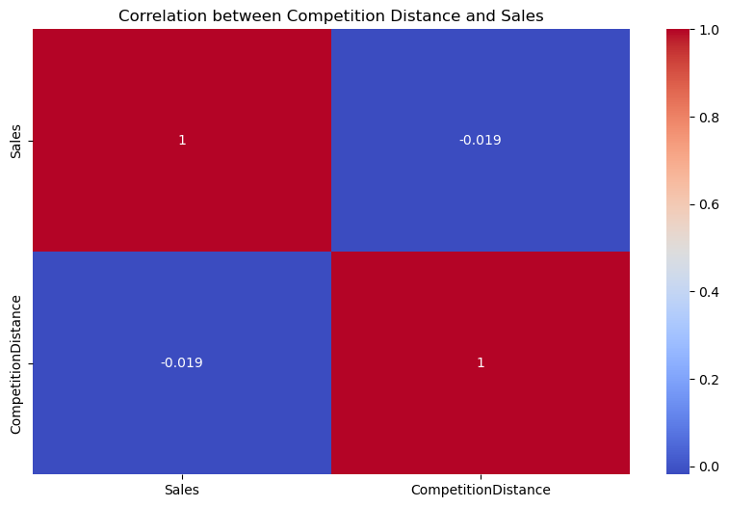
We have negative correlation between Competition Distance and Sales.
Competition Distance is not as much affected on the sales.

Slide 22
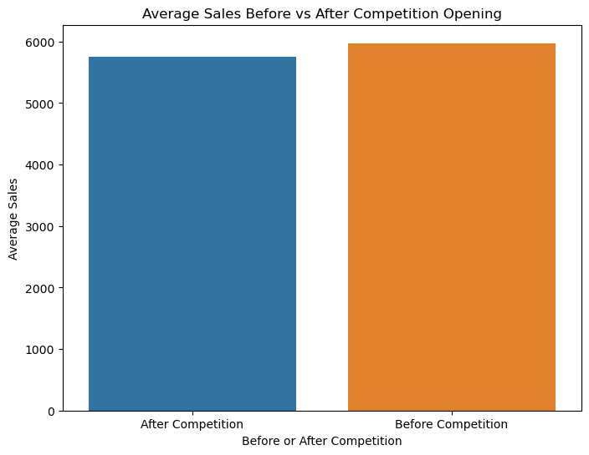
Percentage of sales drop after the competition open: 3.84%.
From above graph we clearly see that the percentage of sales is drop after the competition open.
The value of sales drop is not more but it affects on old sales value in little bit.

Slide 23
Prediction of Store Sales Using Machine Learning Algorithms
Prediction of sales is the central task in this challenge.
We want to predict daily sales in various stores up to 6 weeks ahead of time. This will help the company plan ahead of time.
Preprocessing :
It is important to process the data into a format where it can be fed to a machine learning model.
This typically means converting all non-numeric columns to numeric, handling NaN values and generating new features from already existing features.

Slide 24
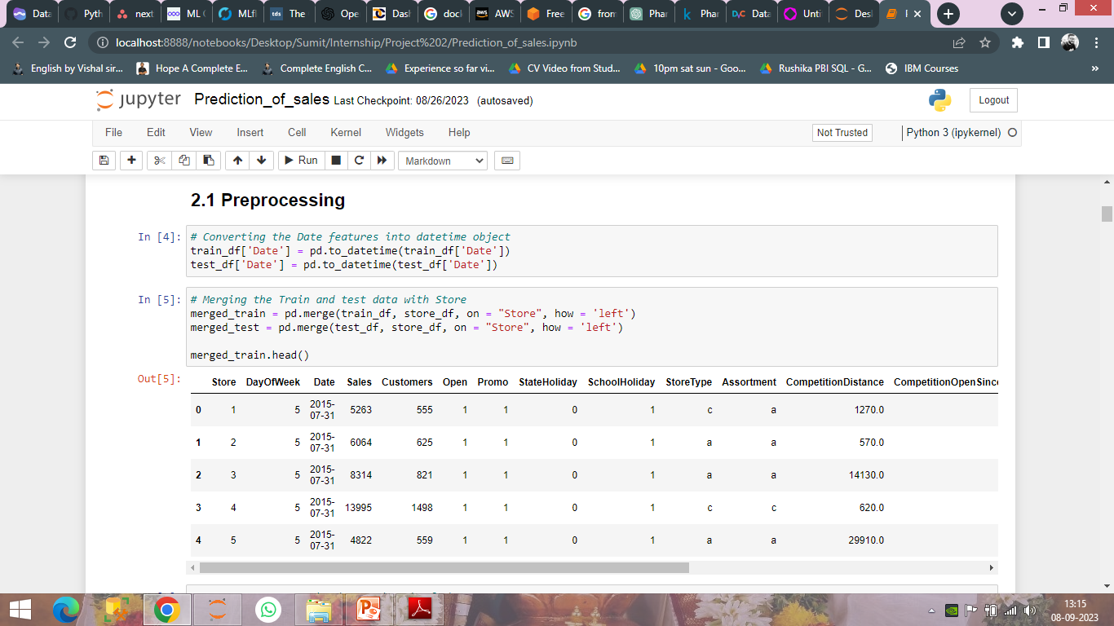

Slide 25
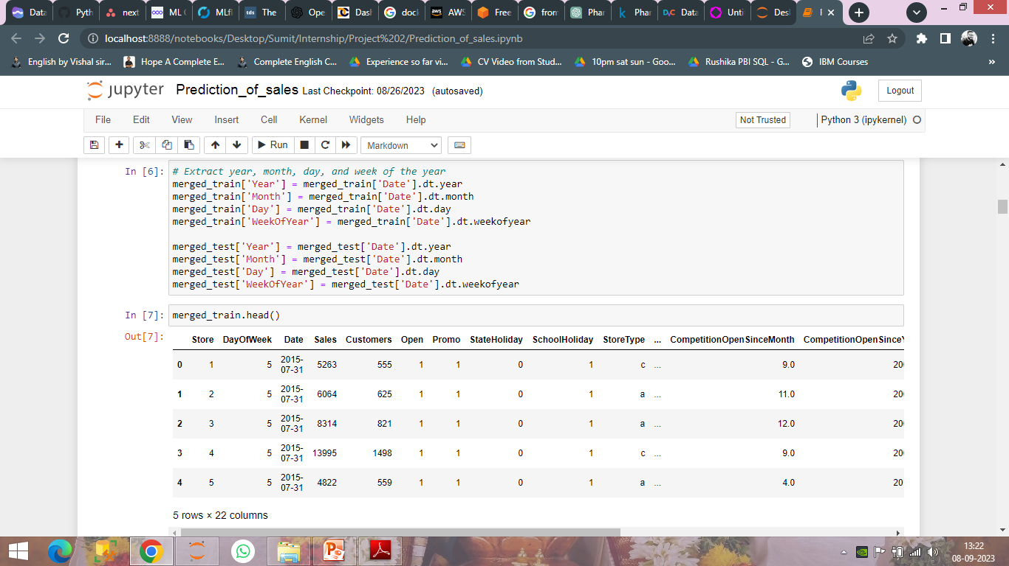

Slide 26
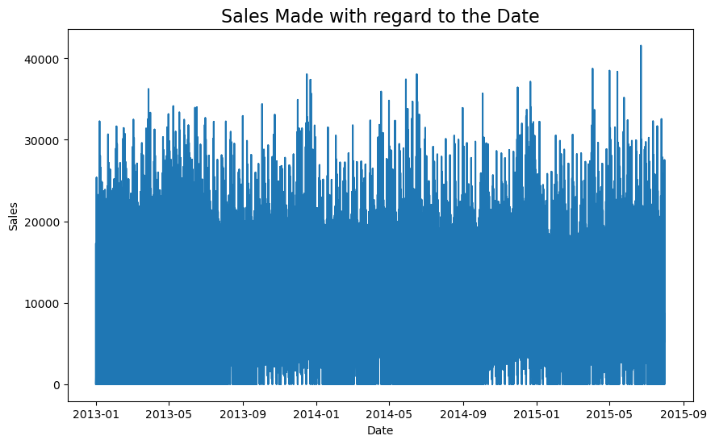

Slide 27
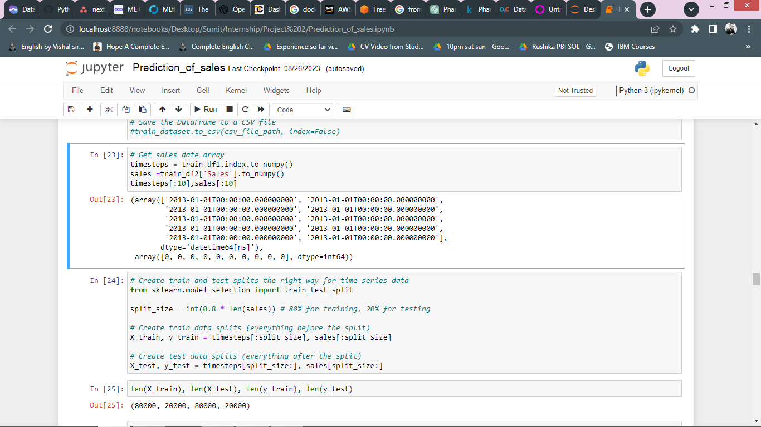

Slide 28
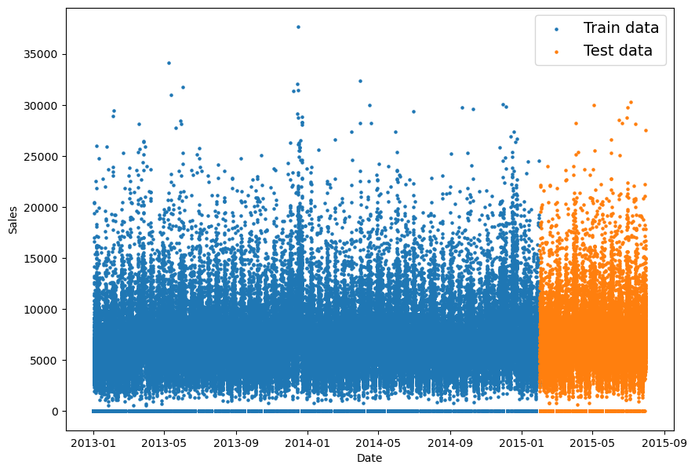

Slide 29
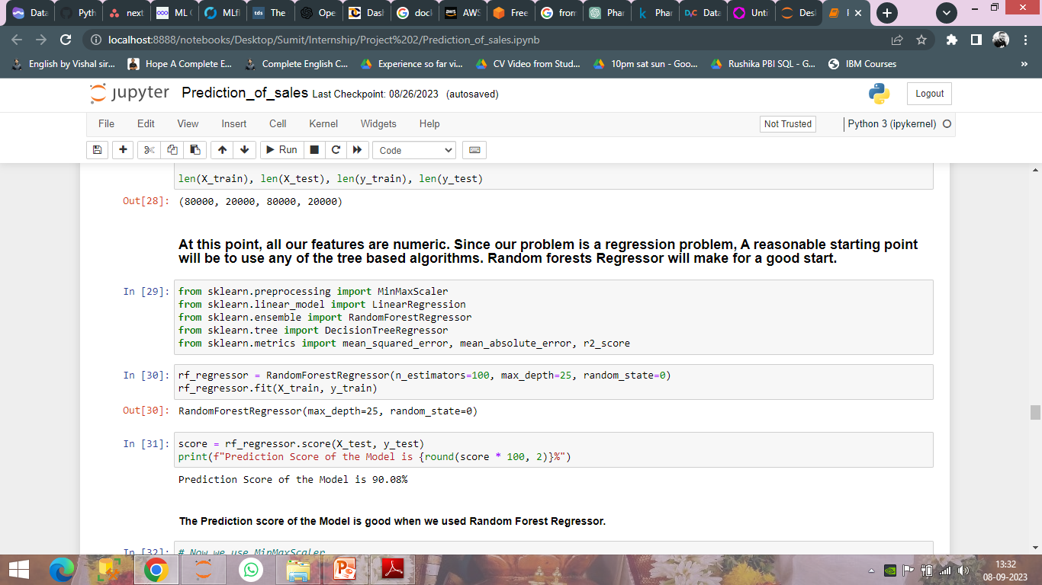

Slide 30
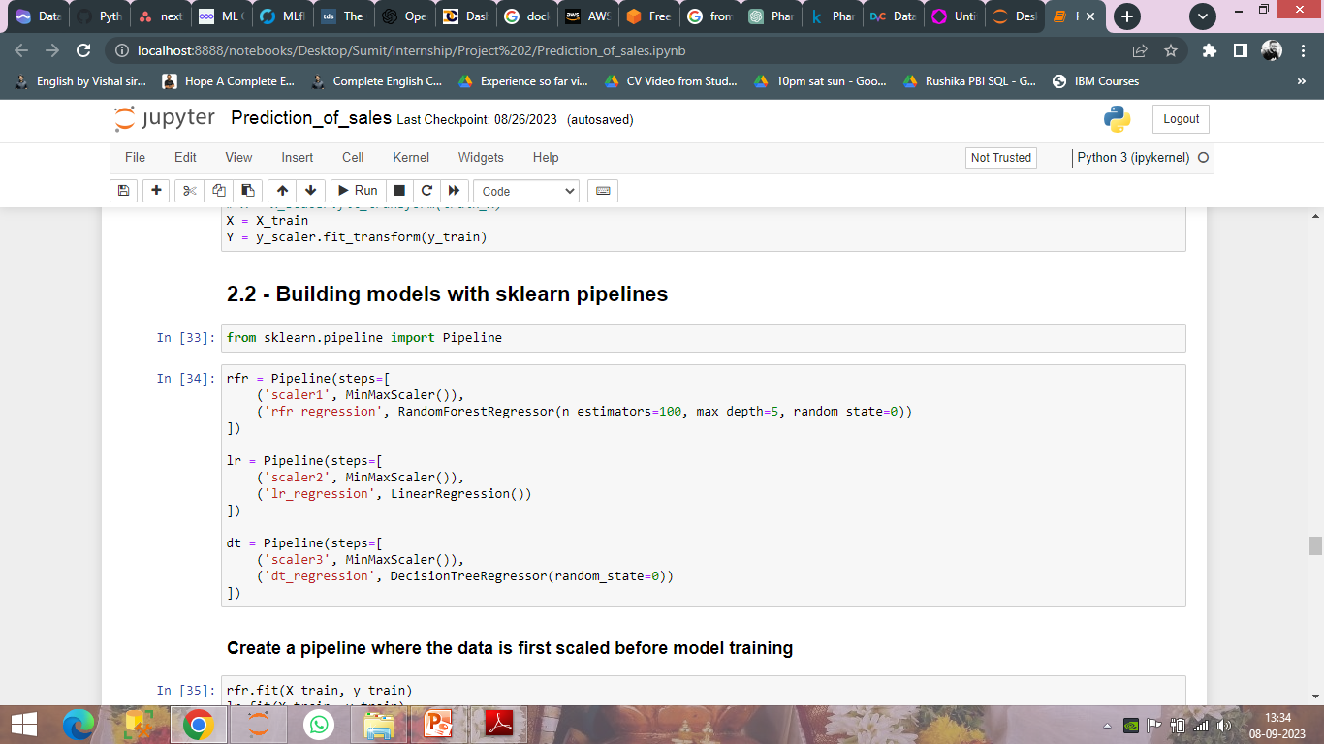

Slide 31
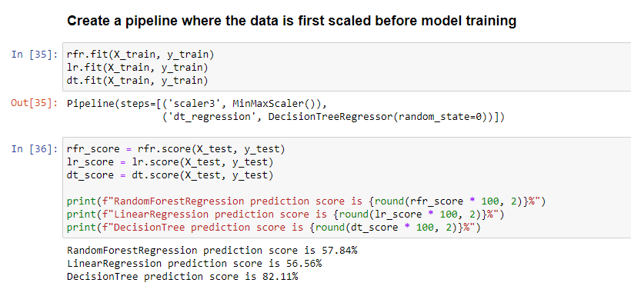

Slide 32
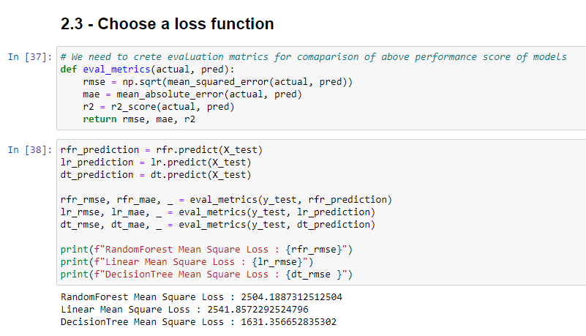
Choosing Mean Square Error as my Loss function

Slide 33
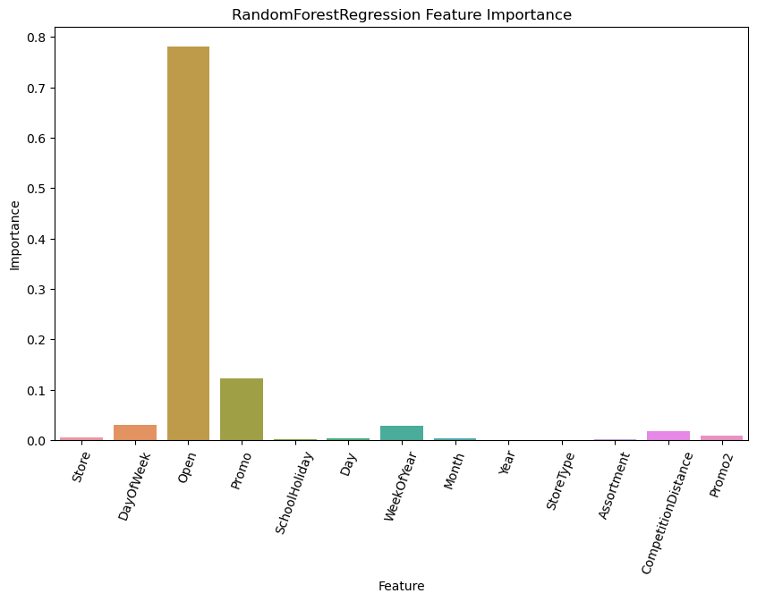

Slide 34
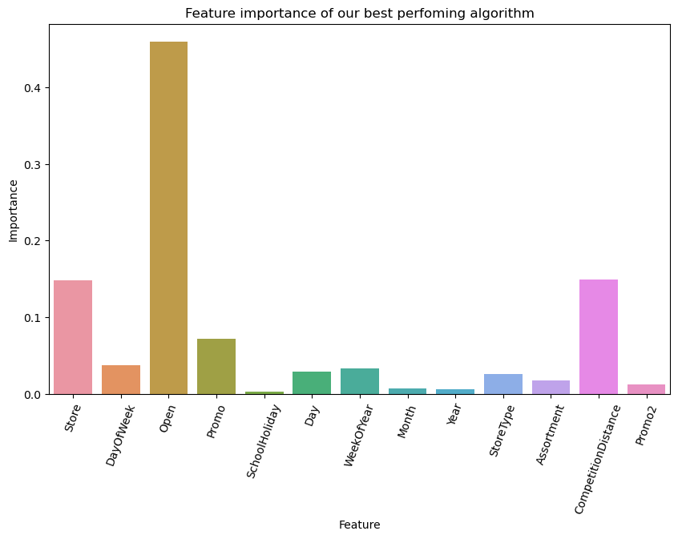
Post Prediction Analysis

Slide 35
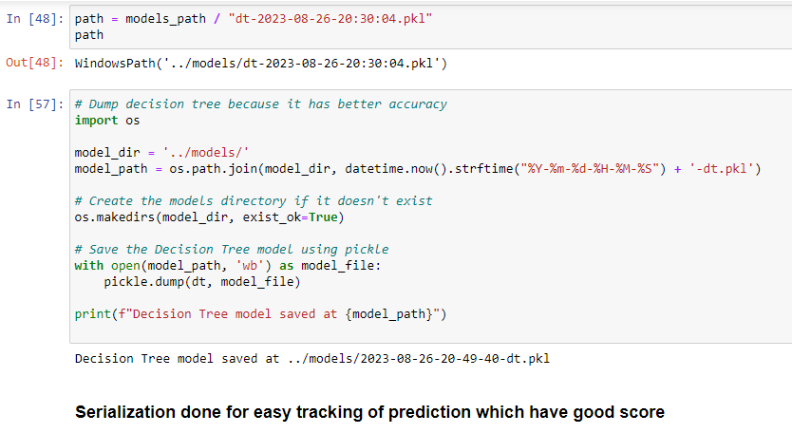
Serialize Models

Slide 36
Building Model with Deep Learning
Deep Learning techniques can be used to predict various outcomes including but not limited to future sales.
We want to create a deep learning model of the Long Short Term Memory which is a type of Recurrent Neural Network ..
Preprocessing :
It is important to process the data into a format where it can be fed to a machine learning model.
This typically means converting all non-numeric columns to numeric, handling NaN values and generating new features from already existing features.

Slide 37
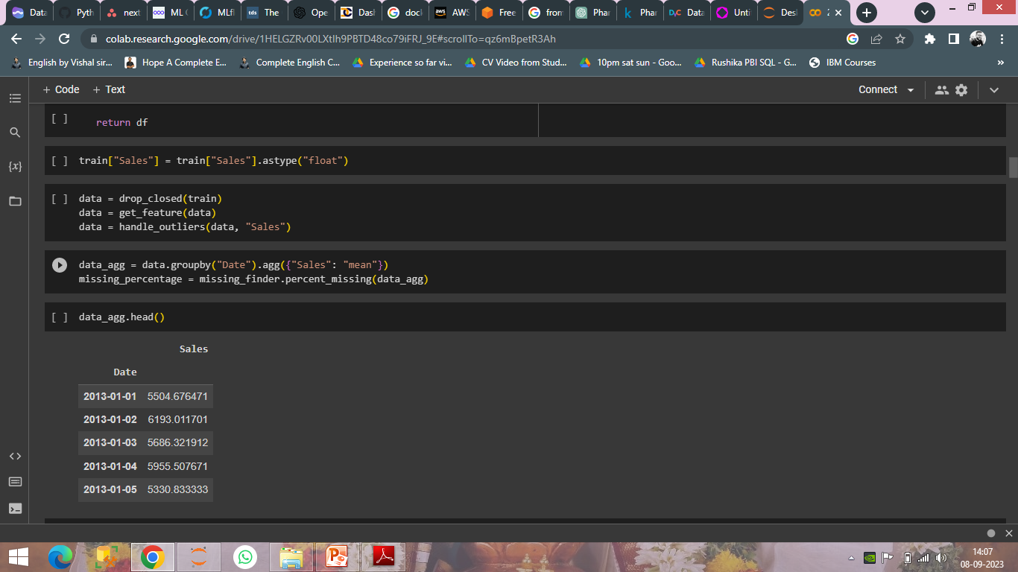
Isolate the Rossmann Store Sales dataset into time series data

Slide 38
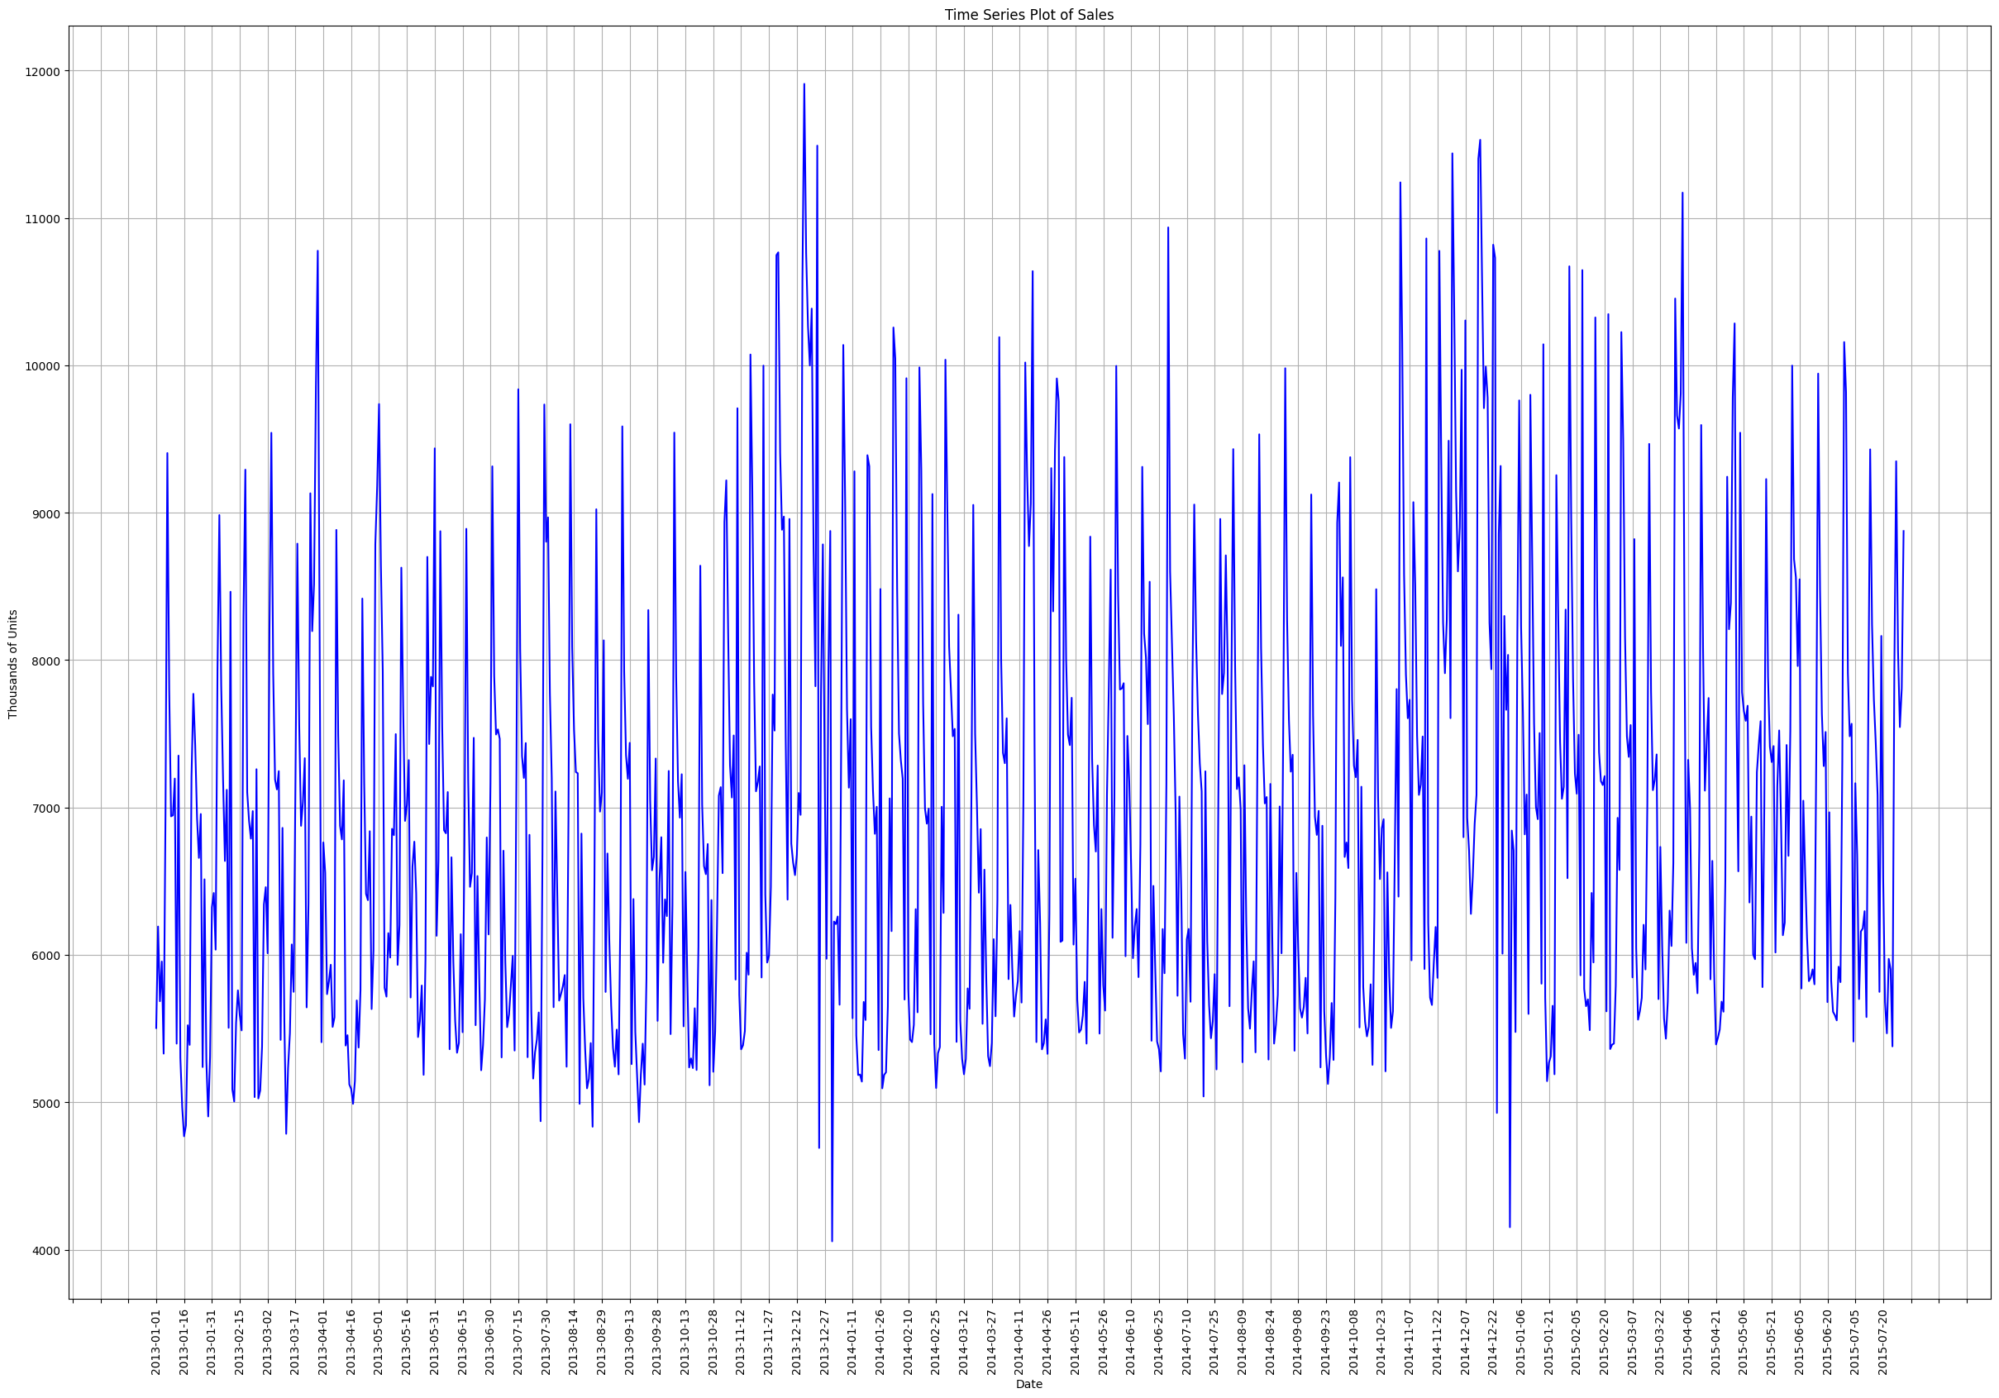

Slide 39
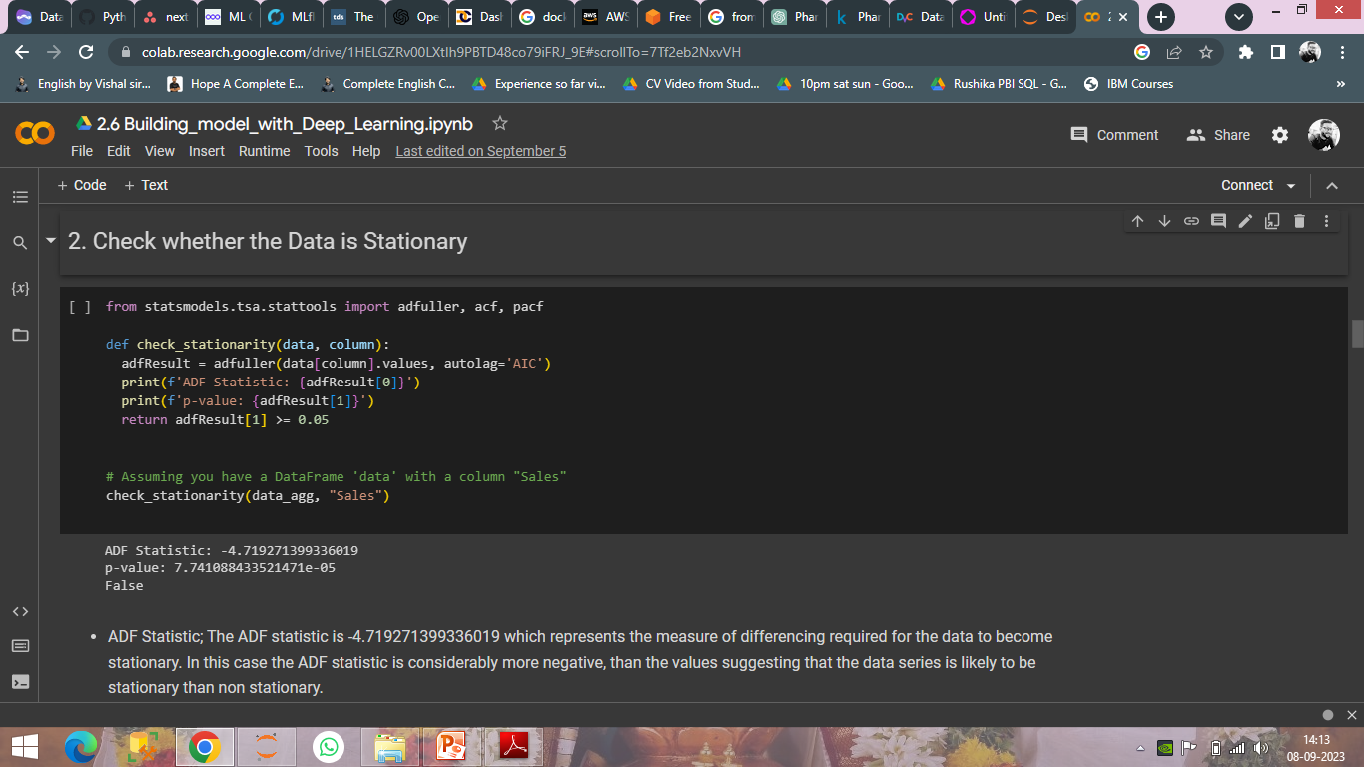
ADF Statistic : The ADF statistic is -4.719271399336019 which represents the measure of differencing required for the data to become stationary. In this case the ADF statistic is considerably more negative, than the values suggesting that the data series is likely to be stationary than non stationary.

Slide 40
p value : The p value associated with the ADF statistic is 7.741088433521471e-05 (a very small value close to 0). The p value helps determine the significance of the ADF statistic. When p value is less than 0.05. it indicates that we can reject the null hypothesis and conclude that the data is non stationary. However in this case a small p value suggests that we can reject the hypothesis and infer that the data is indeed stationary.
Boolean Result : The Boolean result is False because the p value (7.741088433521471e-05) is less than 0.05. This implies that our data can be considered stationary.
Conclusion : Based on our analysis of ADF statistic p value and Boolean result there exists evidence to support concluding that our "Sales" data series demonstrates characteristics of stationarity. The p value being low implies that the data is highly likely to be stationary. This assertion is further supported by the negative value of the ADF statistic.

Slide 41
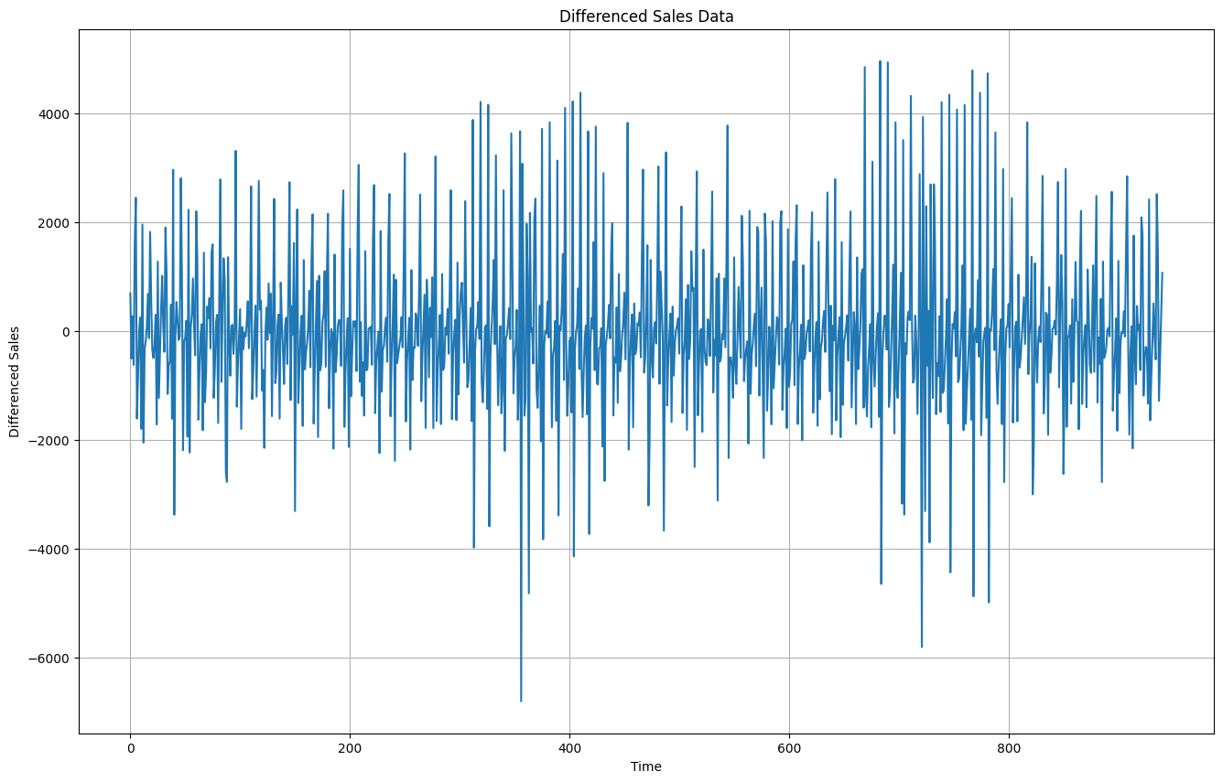

Slide 42
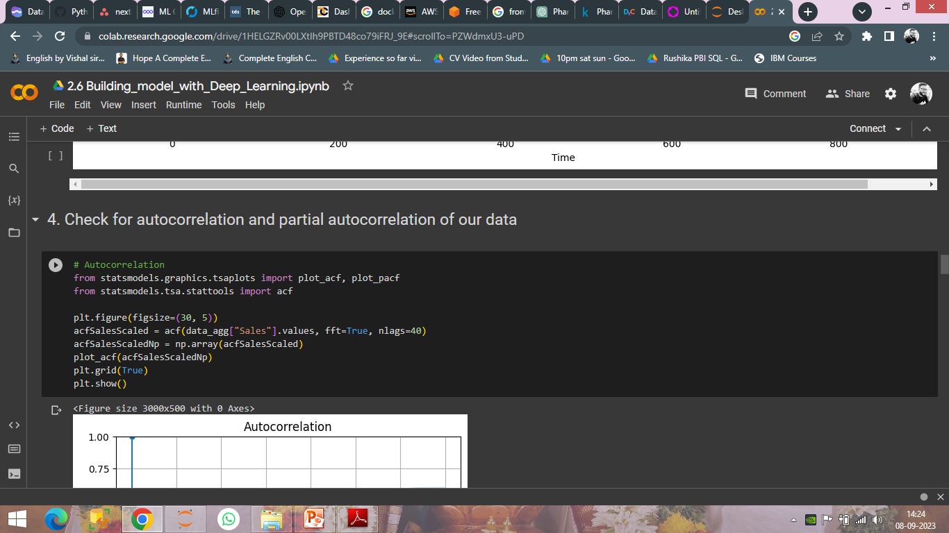
ACF measures the correlation between a time series and its own lagged values at different time lags. Peaks or significant values in the ACF plot at specific lags indicate the presence of a seasonal or periodic pattern in the data.

Slide 43
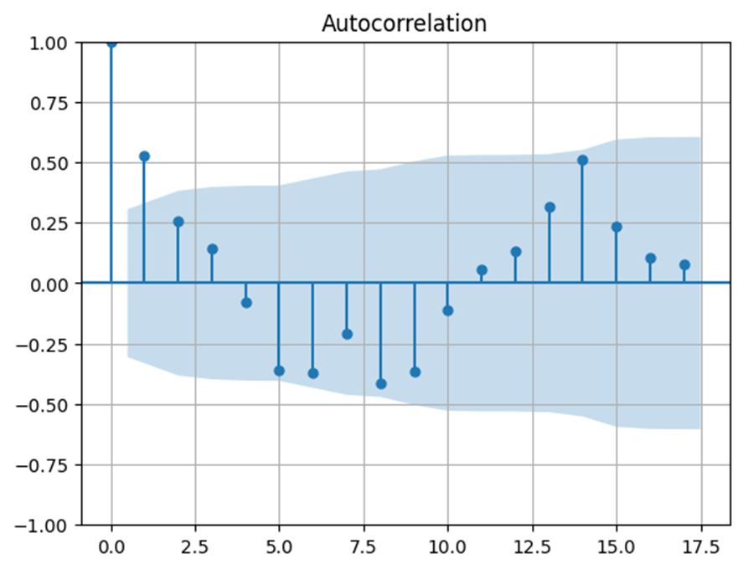
We can see that there is positive lag at points 0,1,2,3,11,12,13,14,15,16,17 and negative lag at points 4,5,6,7,8,9,10. so the lags indicates the presence of seasonal and periodic pattern in the data.

Slide 44
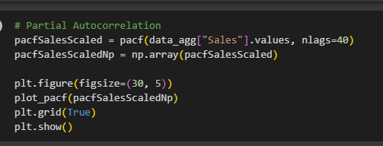
PACF: Examine the PACF plot to identify the order of the autoregressive (AR) component in the data. Significant peaks in the PACF plot suggest the presence of AR terms in the model.

Slide 45
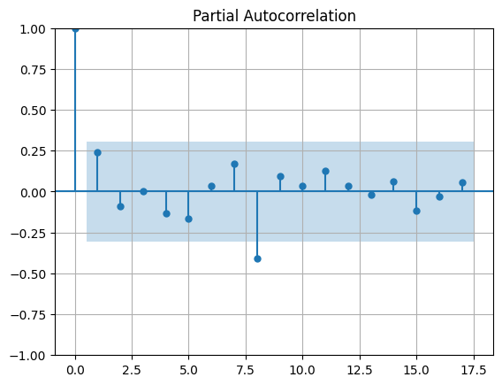
We can see there are significant positive and negative lags on the graph, It indicates that there is presence of an autoregressive (AR) component in the data.
Indicating the presence of an autoregressive (AR) component in time series data means that we have observed significant partial autocorrelation (PACF) values at specific lags in the PACF plot.

Slide 46
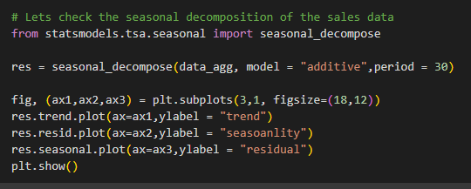

Slide 47
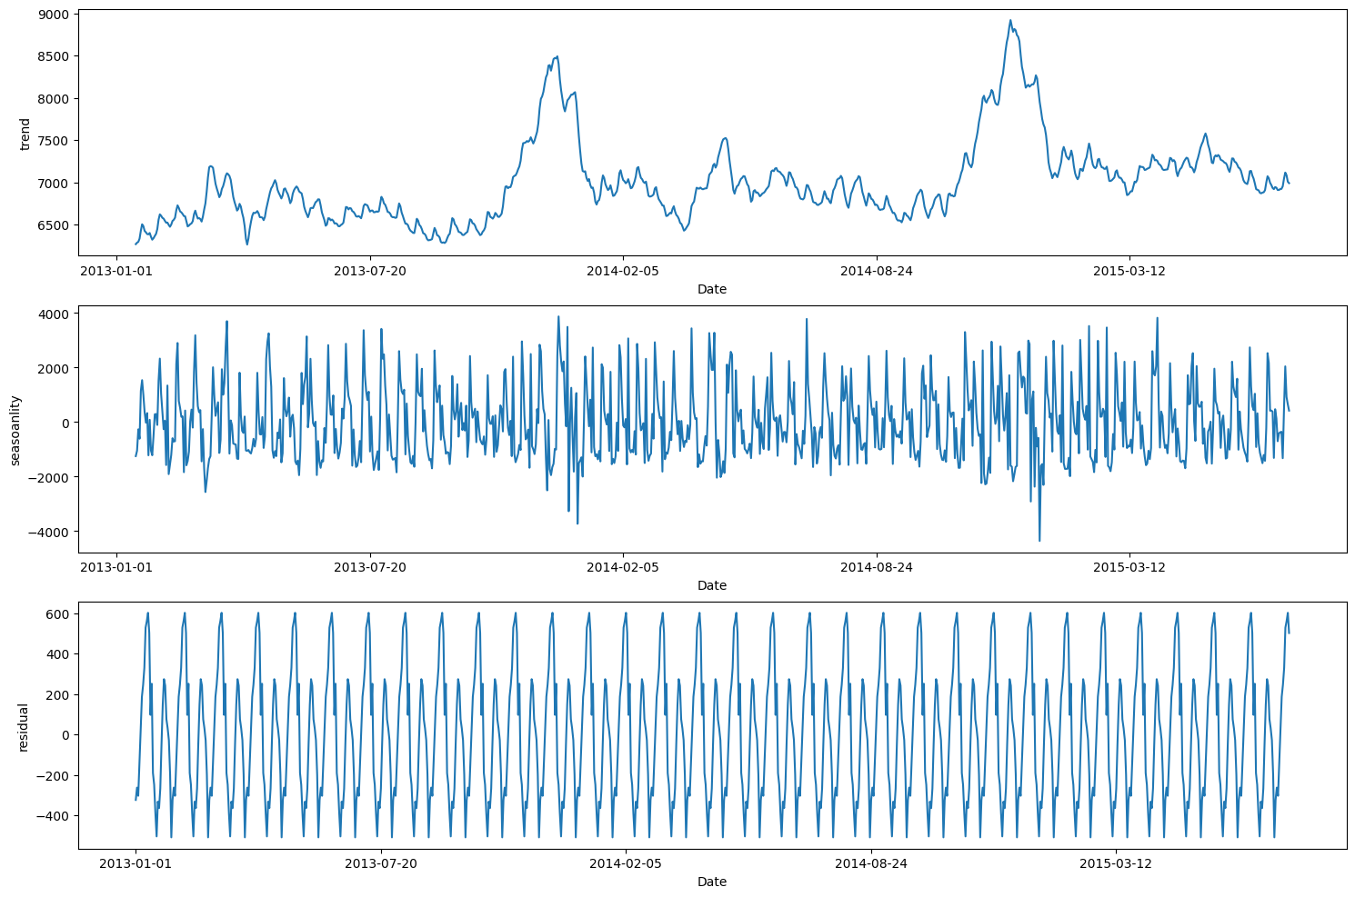

Slide 48
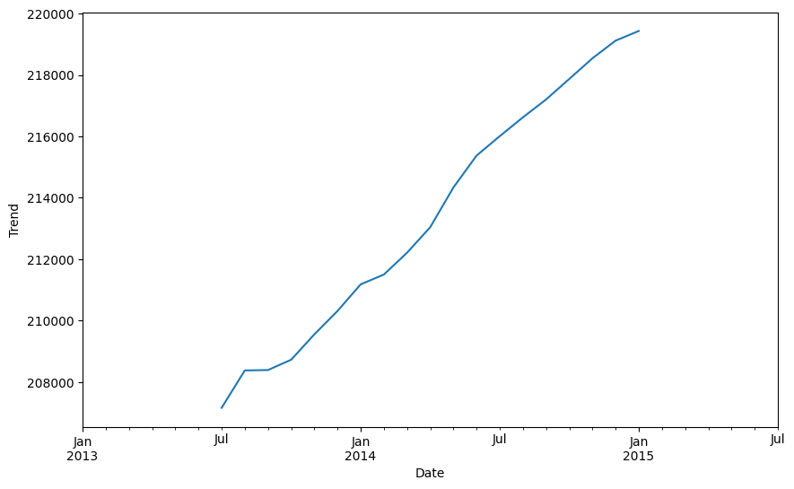

Slide 49
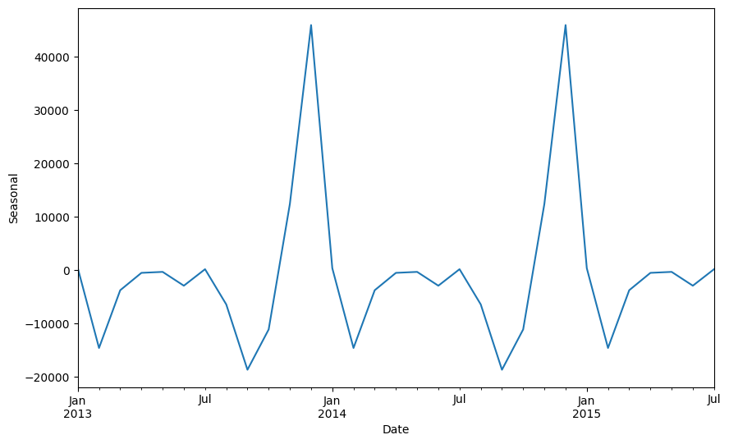

Slide 50
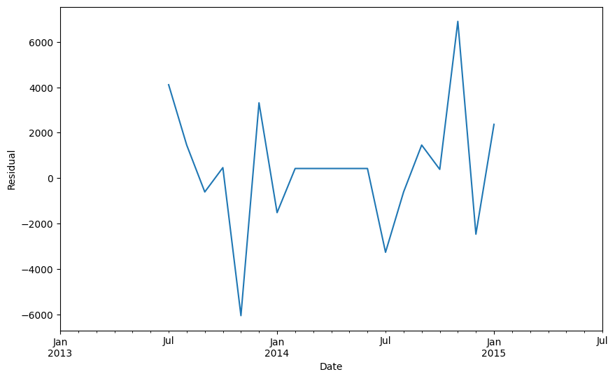

Slide 51
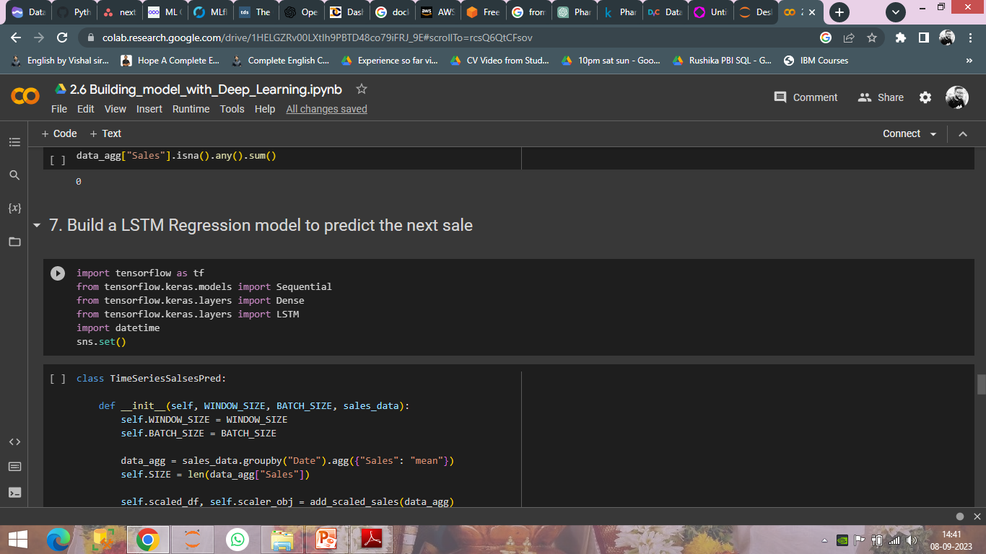
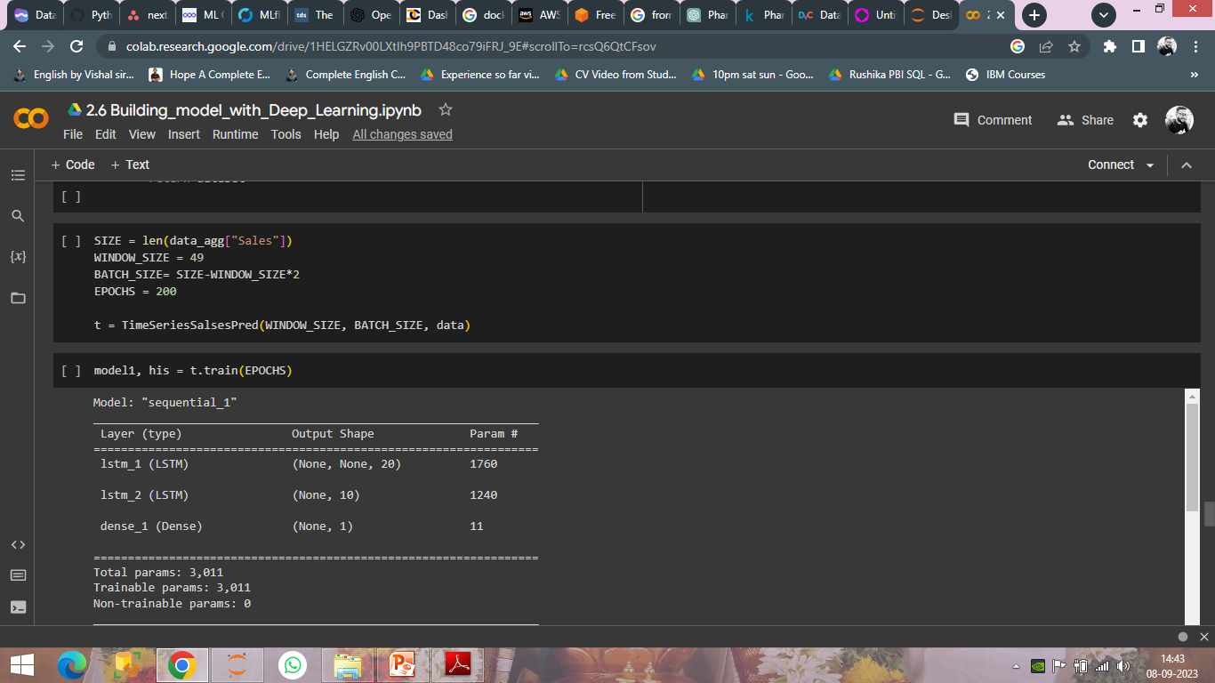

Slide 52
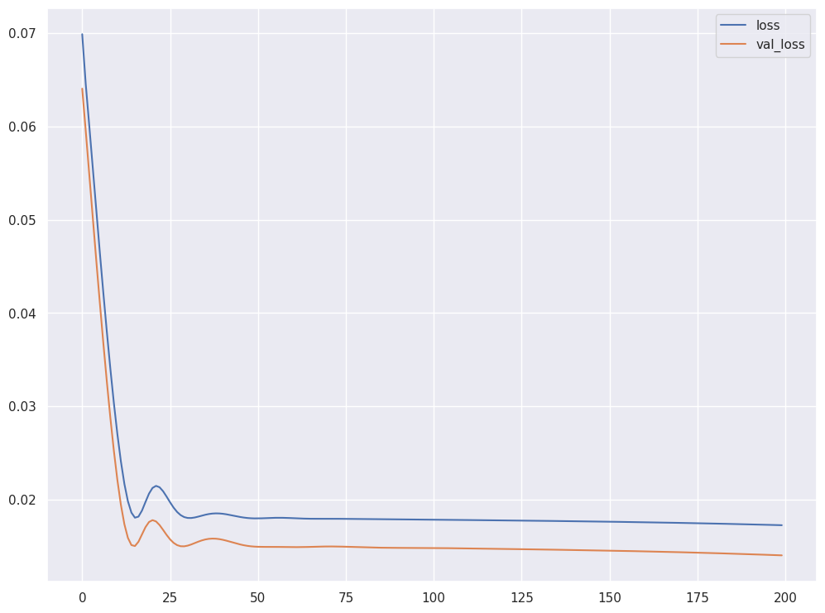

Slide 53
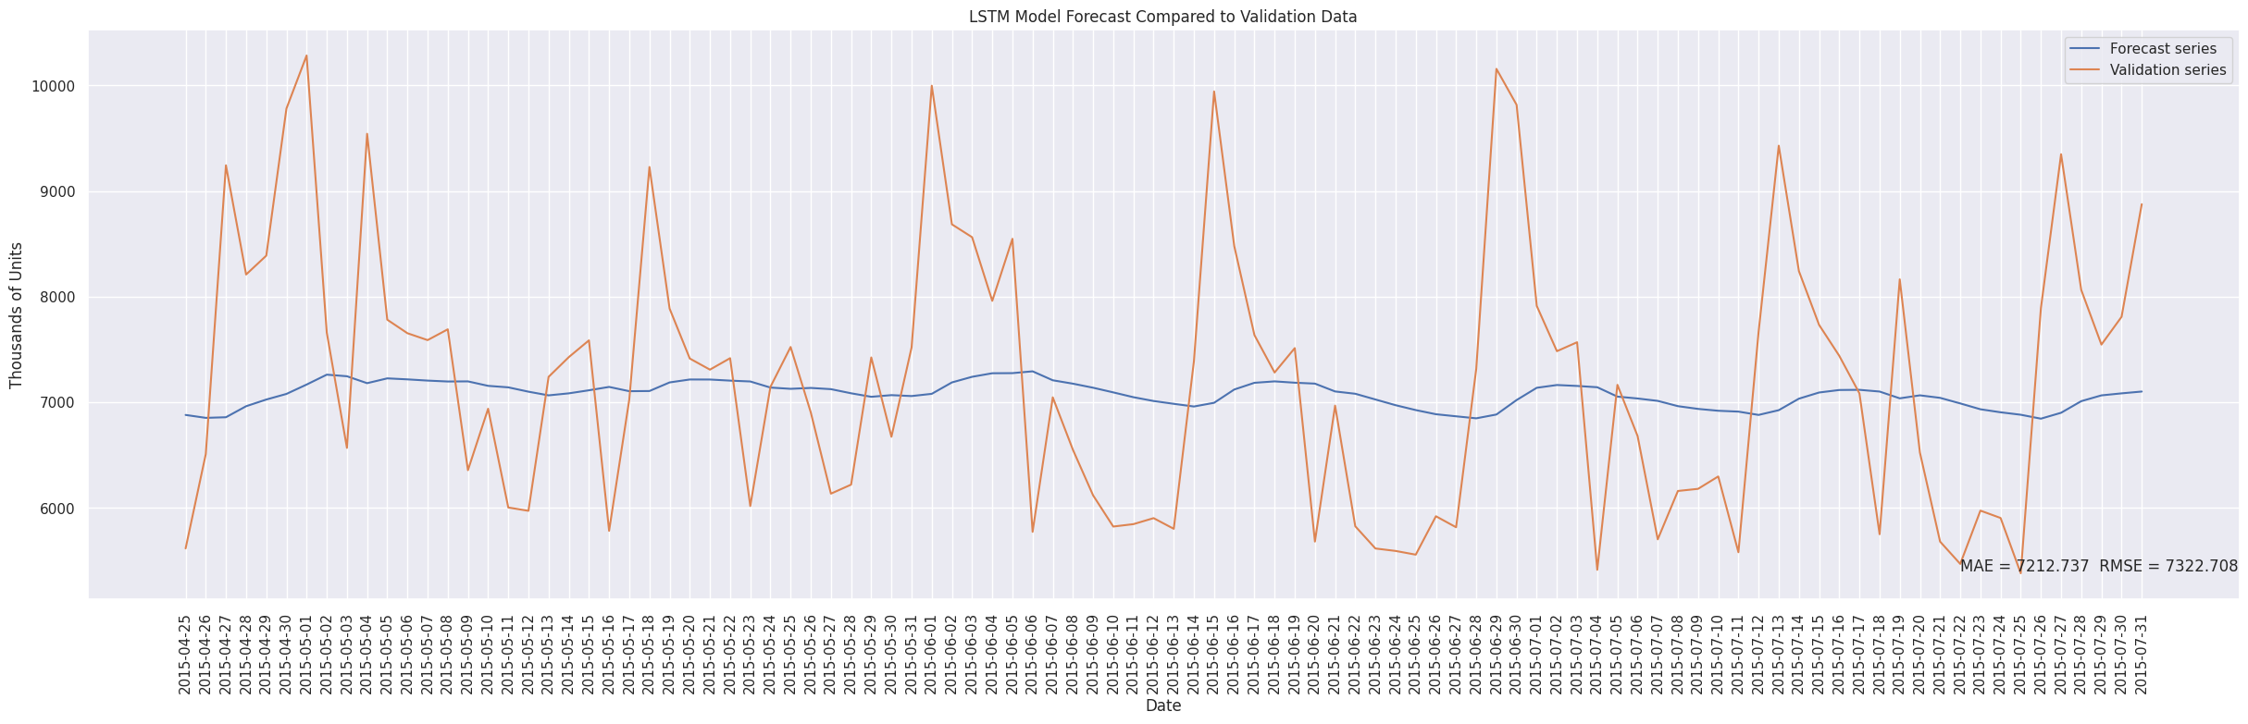

Slide 54
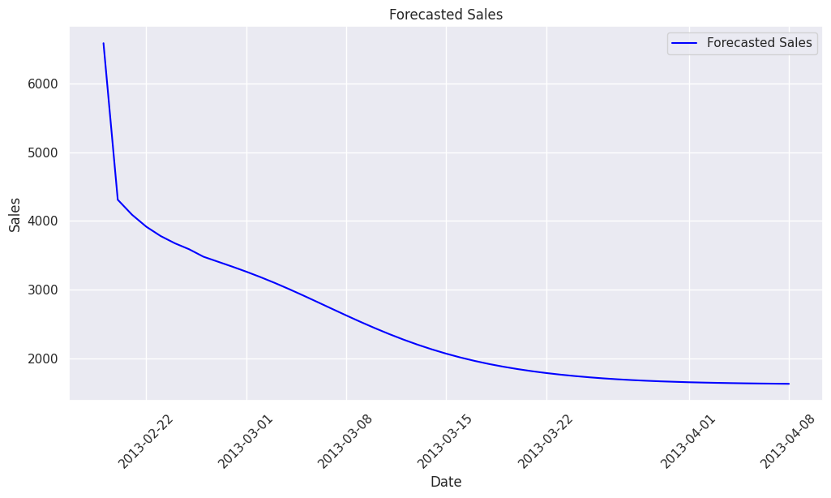

Slide 55
Results
The machine learning models were able to accurately predict the sales of pharmaceutical products for the next six weeks. This allowed Rossman to optimize their inventory and staffing levels, resulting in increased efficiency and profitability.
Conclusion
The Rossman pharmaceutical sales prediction machine learning project was a success. By accurately predicting sales, Rossman was able to optimize their operations and increase profitability.

Slide 56
Thank You

